Slide 1

ENGINEERING FUNDAMENTALS
AUTOMATIC STREET LIGHTS USING ARDUINO

Slide 2
TEAM MEMBERS
1)Sai Teja
2)Sathvik
3)Hemanth
4)Praveen
5)Bhargav
6)Suhitha
7)Vaishnavi
8)Divyasri
9)Lasya
10)Nikhil

Slide 3
ABOUT THIS PROJECT
Automatic street light control is used to control the street lights(Turn on and off based on the light). Here we make use of LDR (Light Dependent Resistor) and LED(Light Emitting diode) and Arduino.
The main purpose of this project is to on and off street lights without manual operation.
By using this system energy consumption is reduced.
Especially in the field of electronics automated system are giving good performance.

Slide 4
Project Description:
1)LDR:-
A photoresistor (or light-dependent resistor, LDR, or photo-conductive cell) is a light-controlled variable resistor. The resistance of a photoresistor decreases with increasing incident light intensity; in other words, it exhibits photoconductivity. A photoresistor can be applied in light-sensitive detector circuits, and light-activated and dark-activated switching circuits.
2)LED:-
A light-emitting diode (LED) is a two-lead semiconductor light source. It is a p–n junction diode that emits light when activated.When a suitable current is applied to the leads,electrons are able to recombine with electron holes within the device, releasing energy in the form of photons.
3)4.7k Resistor:-
A resistor is a passive two-terminal electrical component that implements electrical resistance as a circuit element. In electronic circuits, resistors are used to reduce current flow, adjust signal levels, to divide voltages, bias active elements, and terminate transmission lines, among other uses. High-power resistors that can dissipate many watts of electrical power as heat, may be used as part of motor controls, in power distribution systems, or as test loads for generators. Fixed resistors have resistances that only change slightly with temperature, time or operating voltage
4)Bread Board:-
A breadboard is a construction base for prototyping of electronics. Originally it was literally a breadboard, a polished piece of wood used for slicing bread. In the 1970s the solderless breadboard (a.k.a. plugboard, a terminal array board) became available and nowadays the term "breadboard" is commonly used to refer to these.
5)Arduino:-
Arduino Uno is a microcontroller board based on the ATmega328P (datasheet). It has 14 digital input/output pins (of which 6 can be used as PWM outputs), 6 analog inputs, a 16 MHz quartz crystal, a USB connection, a power jack, an ICSP header and a reset button. It contains everything needed to support the microcontroller; simply connect it to a computer with a USB cable or power it with a AC-to-DC adapter or battery to get started.. You can tinker with your UNO without worrying too much about doing something wrong, worst case scenario you can replace the chip for a few dollars and start over again.

Slide 5
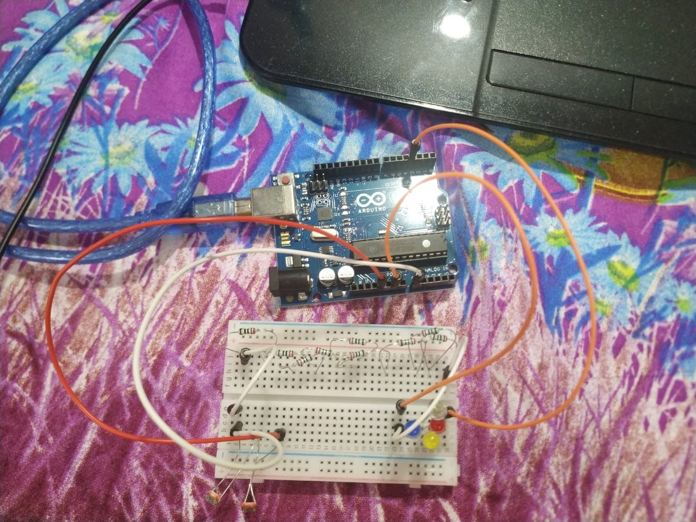
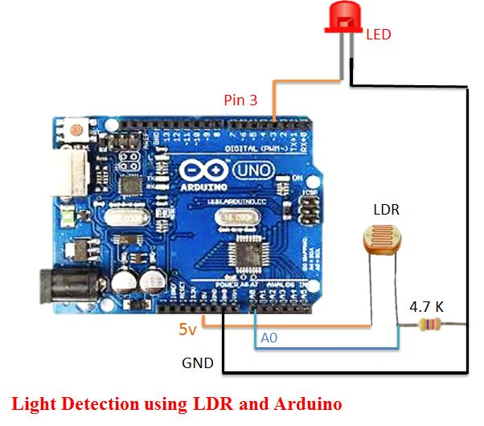

Slide 6
THANK YOU

